Slide 1
Click
Fits any
Click Sensor Hub PCB
MikroBUS
Socket #1
MikroBUS
Socket #2
FRDM-KL46Z Board
USB Type B
Connection
MikroBUS
Socket #3
MikroBUS
Socket #4
10V/1A
Connection

Slide 2
Click
Fits any
Click Sensor Hub PCB
MikroBUS
Socket #1
MikroBUS
Socket #2
FRDM-KL46Z Board
USB Type B
Connection
MikroBUS
Socket #3
MikroBUS
Socket #4
10V/1A
Connection

Slide 3
Click Sensor Hub PCB
mikroBUS
Socket #1
mikroBUS
Socket #2
FRDM-KL46Z Board
mikroBUS
Socket #3
mikroBUS
Socket #4

Slide 4
Click Sensor Hub PCB
MikroBUS
Socket #1
MikroBUS
Socket #2
1 Shared UART to 2 SPI
3:8 Encoder
2:4 Encoder
MikroBUS
Socket #3
MikroBUS
Socket #4

Slide 5

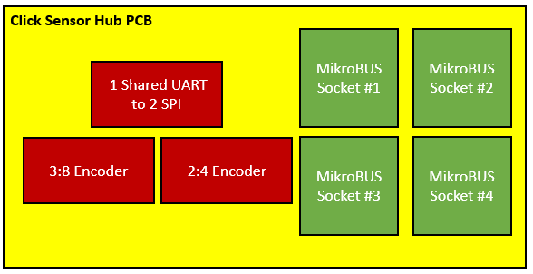

Slide 6
Legend
FRDM-KL46Z
- shared line
- single line
Analog
4 Analog Pins
SPI
4 Slave Select Pins
3 Shared Pins for MISO, MOSI and CLK
UART
4 RX Pins
4 TX Pins
I2C
1 Shared SDA Pin
1 Shared SCL Pin
PWM
4 PWM Pins

Slide 7
CLICK NAME | Description and Interface | Interface | Requirement | Status
Temp&Hum 2 Click | Measures a wide range of temperature and relative humidity values with a great accuracy | I2C | Non-Zero Putty output reading | Fail
USB UART 3 click | Adds USB 2.0 functionality | Serial | Non-Zero Putty output reading | Fail
Color 5 click | Integrated color sensing device | I2C | Non-Zero Putty output reading | Fail
BarGraph 2 Click | 10-segment bar graph display click, which uses a high-quality, multicolor bar graph LED display | PWM & SPI | Pattern displayed on bar graph | Pass
Accel 5 click | Triaxial accelerometer sensor | I2C & SPI | Non-Zero Putty output reading | Fail
Gaussmeter click | Gaussmeter used for measuring the magnetic field in X, Y and Z axes | I2C & SPI | Non-Zero Putty output reading | Pass
LightRanger 3 Click | Accurate distance measurement based on a ToF (Time of Flight) measurement principle | I2C | Non-Zero Putty output reading | Pass
Alcohol Click | Portable alcohol detector, breathalyzer for estimating BAC | Analog | Non-Zero Putty output reading | Pass
Air Quality Click | detecting a variety of gases that impact air quality in homes and offices | Analog | Non-Zero Putty output reading | Pass
microSD click | A microSD card slot for microSD cards used as a mass storage media for portable devices | SPI | Non-Zero Putty output reading | Pass

